Slide 1
Advance Structure Analysis
“Stiffness Matrix Method”
By: Asst. prof Dr. Wissam D. Salman

Slide 2
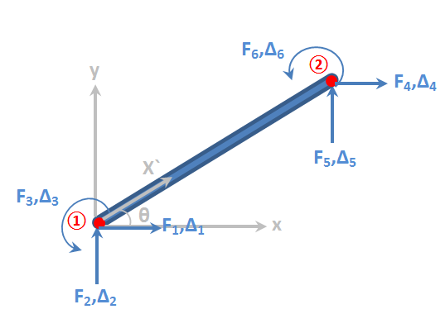
Frame ****
Plane beam element stiffness matrix in global system:
Beam Element In Global Coordinate System

Slide 3
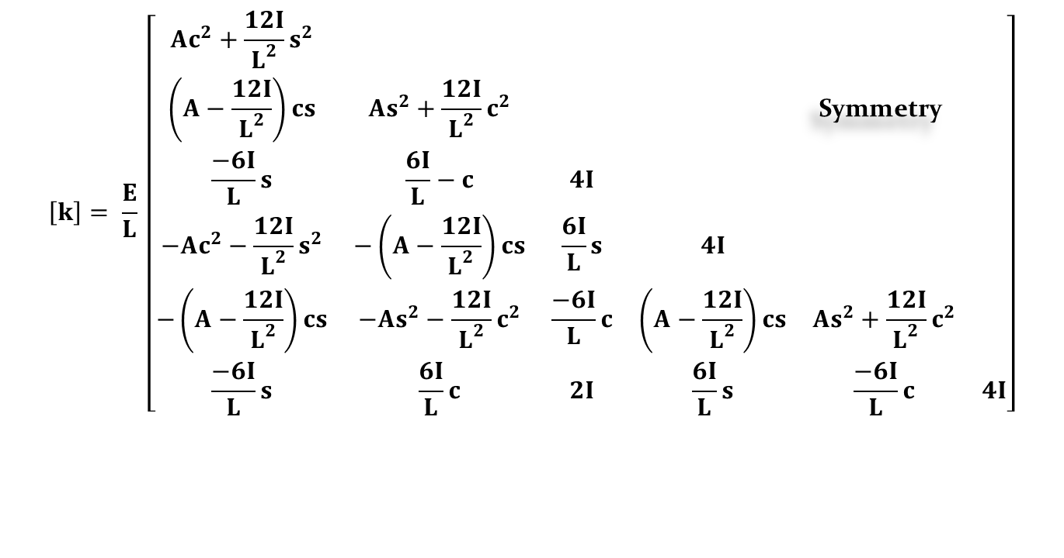
$$\left[k\right]= \frac{E}{L} \left[\begin{matrix}Ac^{2}+\frac{12I}{L^{2}}s^{2} & & & & & \\ \left(A−\frac{12I}{L^{2}}\right)cs & As^{2}+\frac{12I}{L^{2}}c^{2} & & & \text{Symmetry} & \\ \frac{−6I}{L}s & \frac{6I}{L}−c & 4I & & & \\ −Ac^{2}−\frac{12I}{L^{2}}s^{2} & −\left(A−\frac{12I}{L^{2}}\right)cs & \frac{6I}{L}s & 4I & & \\ −\left(A−\frac{12I}{L^{2}}\right)cs & −As^{2}−\frac{12I}{L^{2}}c^{2} & \frac{−6I}{L}c & \left(A−\frac{12I}{L^{2}}\right)cs & As^{2}+\frac{12I}{L^{2}}c^{2} & \\ \frac{−6I}{L}s & \frac{6I}{L}c & 2I & \frac{6I}{L}s & \frac{−6I}{L}c & 4I\end{matrix}\right]$$
Beam Element Stiffness Matrix In Global Coordinate System

Slide 4
$$\left[k\right]= \frac{EI}{L^{3}} \left[\begin{matrix}12 s^{2} & −12 cs & −6 L s & −12 cs & 12 cs & −6 L s \\ −12 cs & 12 c^{2} & 6 L c & 12 cs & −12 c^{2} & 6 L c \\ −6 L s & 6 L c & 4 L^{2} & 6 L s & −6 L c & 2 L^{2} \\ −12 s^{2} & 12 cs & 6 L s & 12 s^{2} & −12 cs & 6 L s \\ 12 cs & −12 c^{2} & −6 L c & −12 cs & 12 c^{2} & −6 L c \\ −6 L s & 6 L c & 2 L^{2} & 6 L s & −6 L c & 4{ L}^{2}\end{matrix}\right]$$
Stiffness Matrix For Beam Element In Global Coordinate System “Neglect The Axial Deformation”

Slide 5
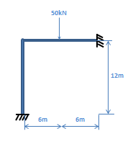
Example: Use the stiffness matrix method to analyze the rigid frame shown in figure, (Find the displacement and member forces) neglected the axial deformation.

Slide 6
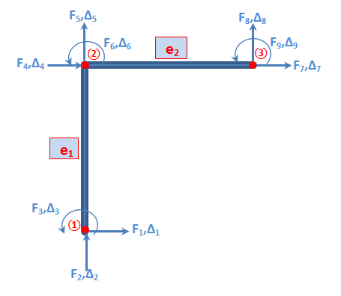
Solution:
Ele. | node | Ѳ | c | s | cs | c² | s² | EI/L³
1 | 1-2 | 90 | 0 | 1 | 0 | 0 | 1 | EI/L³
2 | 2-3 | 0 | 1 | 0 | 0 | 1 | 0 | EI/L³

Slide 7
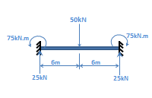
From B.C. ∆₁ , ∆₂ , ∆₃ , ∆₇ , ∆₈ , ∆₉ equal to zero
From neglected axial deformation ∆₄ , ∆₅ equal to zero
:. Unknown ∆₆ only
Use the F.E.M to travel the load
F₆ = -75 kN (final)
F₈* = 25 kN
F₉* = -75 kN

Slide 8
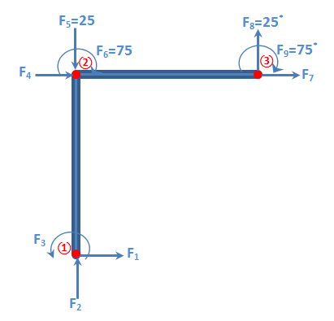

Slide 9
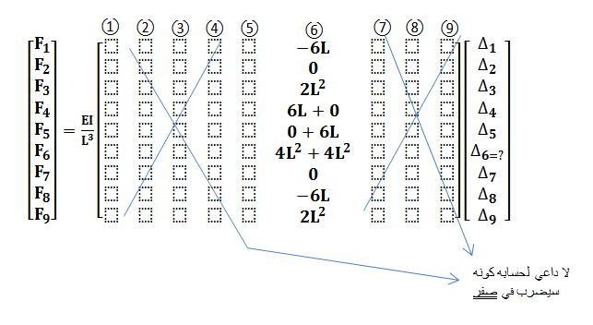
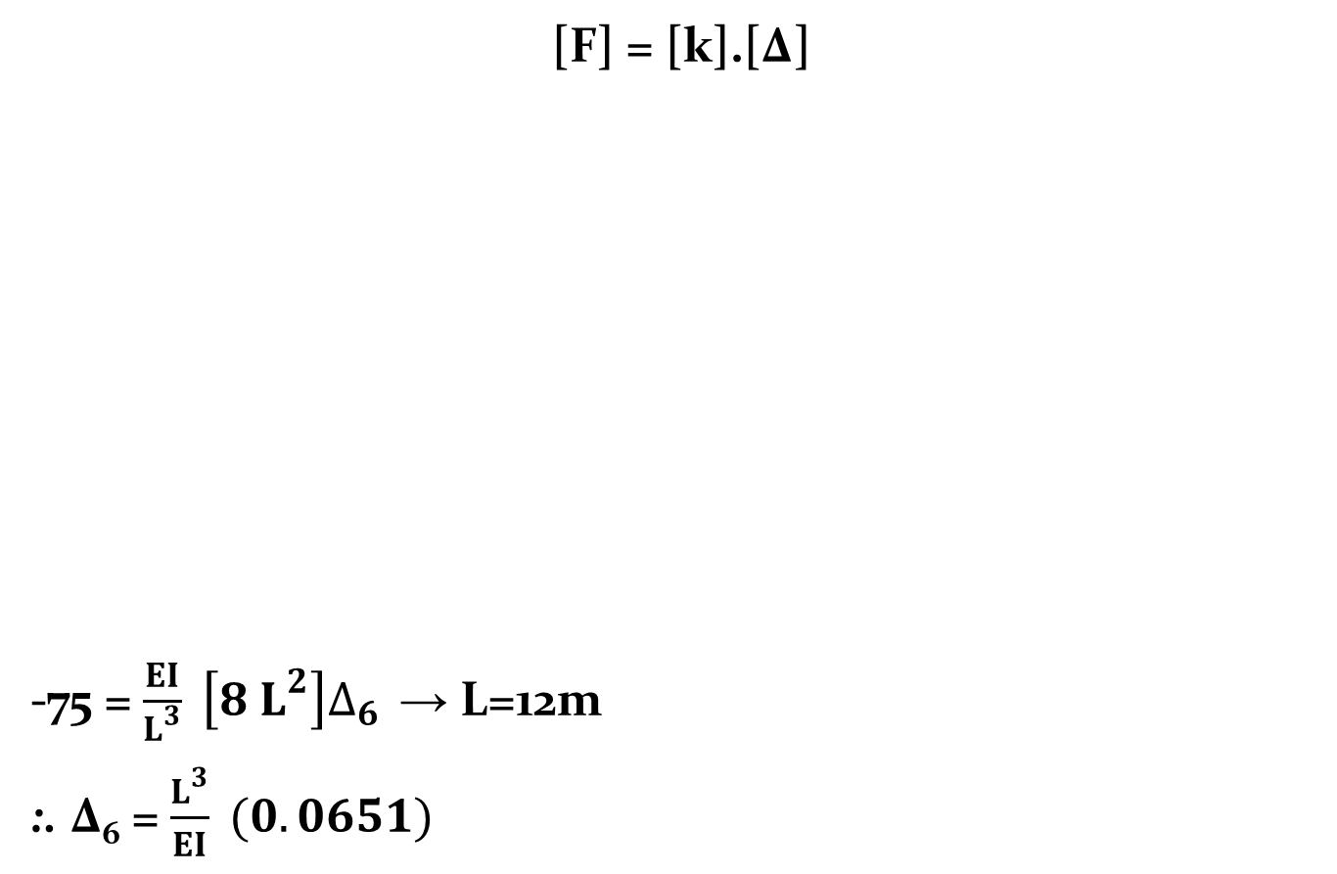
[F] = [k].[∆]
-75 = $\frac{EI}{L^{3}} \left[8 L^{2}\right]∆_{6 }$ → L=12m
:. ∆₆ = $\frac{L^{3}}{EI} (0.0651)$

Slide 10
F₁ = 4.6872 kN →
F₂ = 0
F₃ = -18.75 = +18.75 kN.m
F₇ = 0
F₈ = 4.6872 + 25* = 29.6872 kN ↑
F₉ = -18.75 – 75* = -93.75 = + 93.75 kN.m

Slide 11
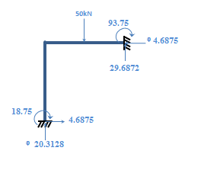
:. Final reactions:-

Slide 12
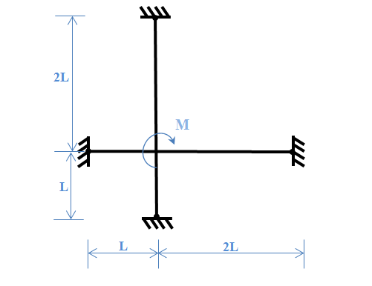
H.W1: Find the displacement and supports reactions for the open frame shown in figure, use:
The stiffness matrix method.
Slop deflection method.
Moment distribution method.

Slide 13
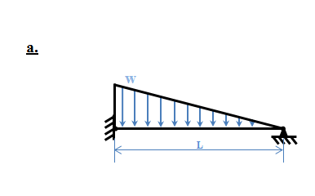
H.W2: Use stiffness matrix method and slop deflection method to analyze the structures shown in figures:
Answer

Slide 14
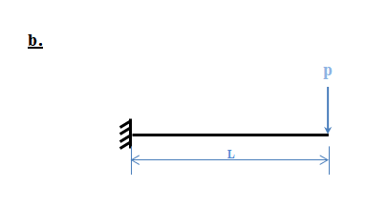

Slide 15
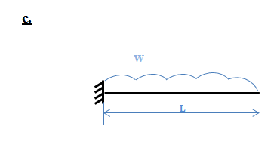

Slide 16
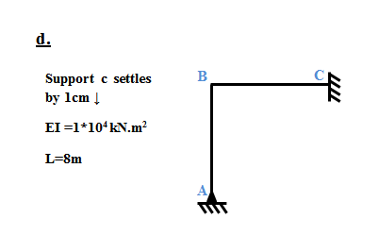

Slide 17
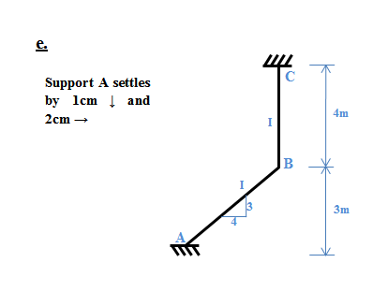

Slide 18
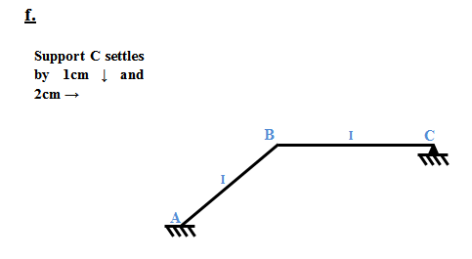

Slide 19
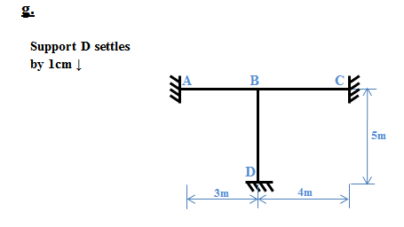

Slide 20
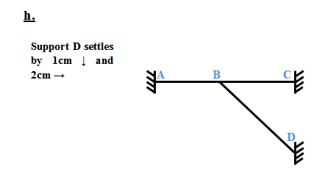

Slide 21
